Slide 1
Application of complex network theory to the contents of science subjects in high school education
JUAN FERNÁNDEZ GRACIA, ANTONI SALVÀ SALVÀ
Contact: juanf@ifisc.uib-csic.es

Slide 2
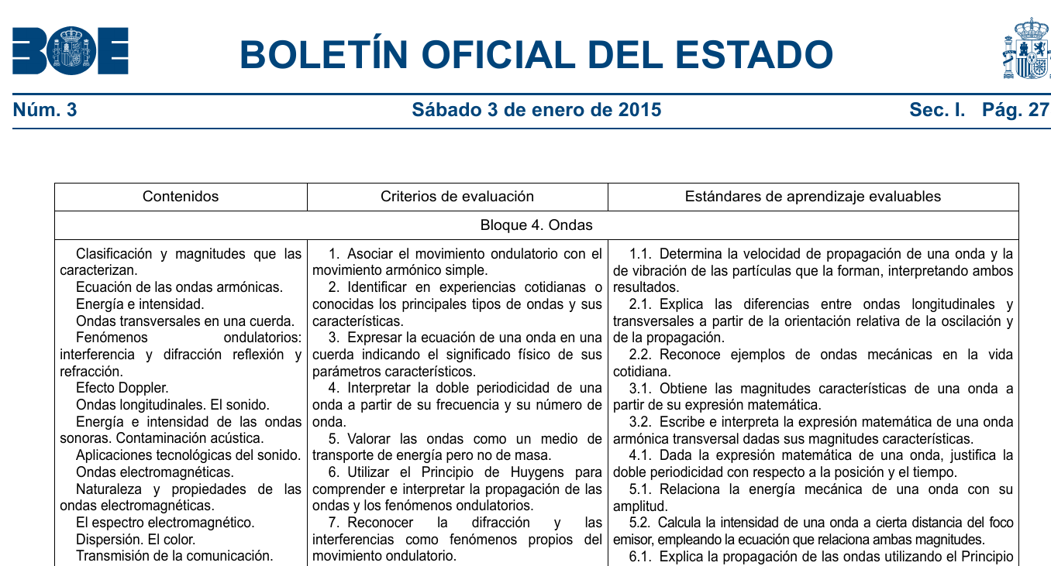
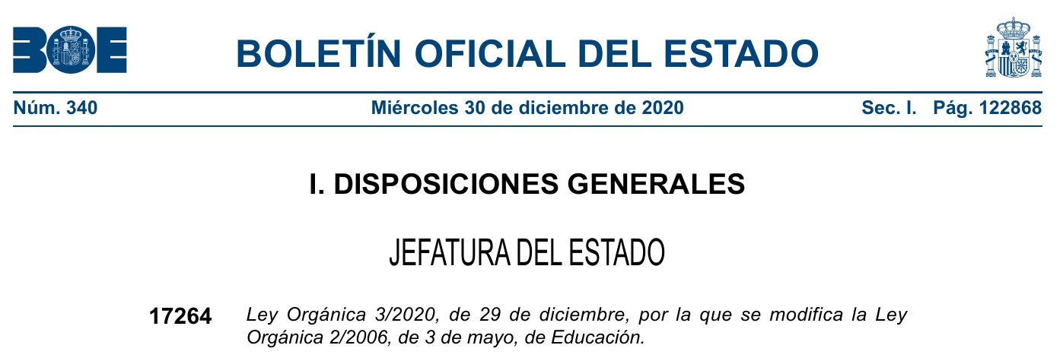
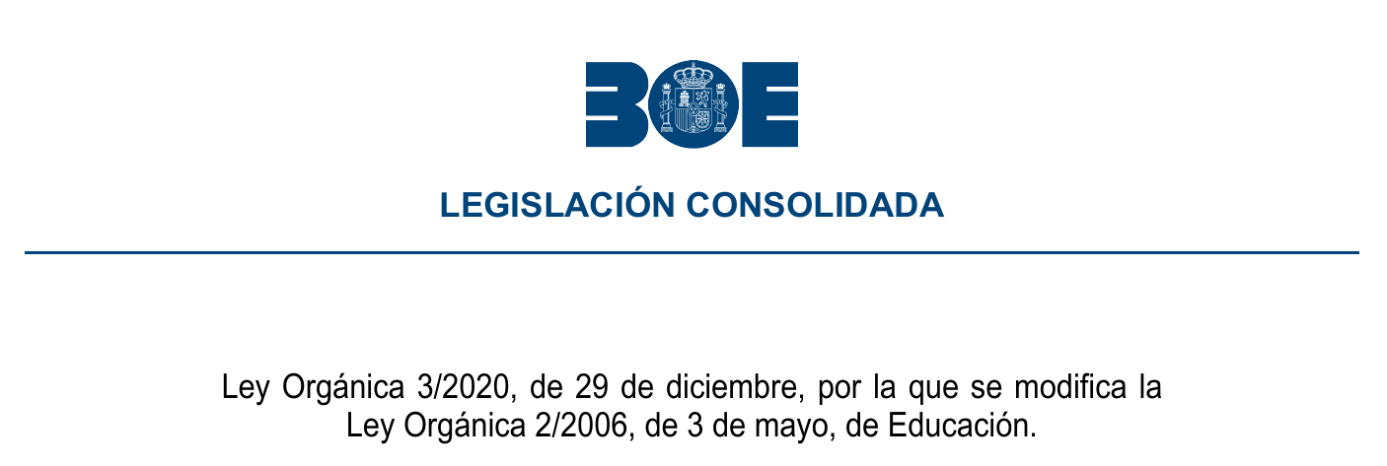
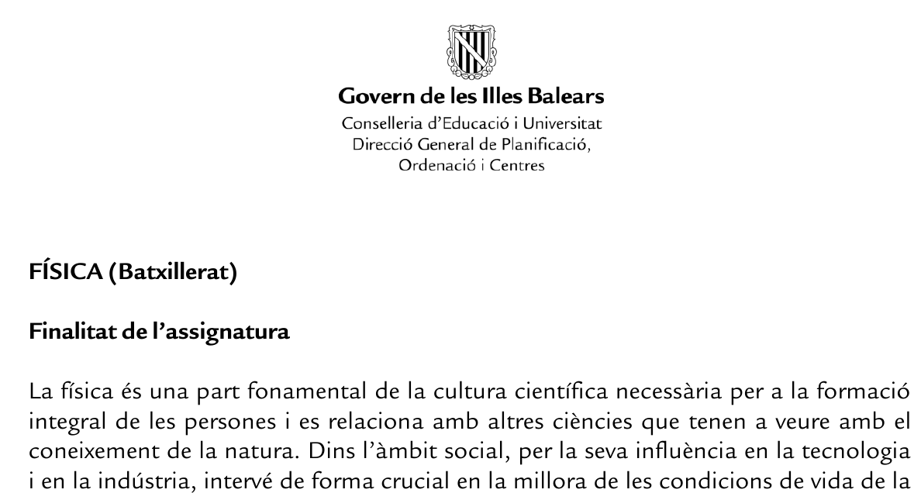
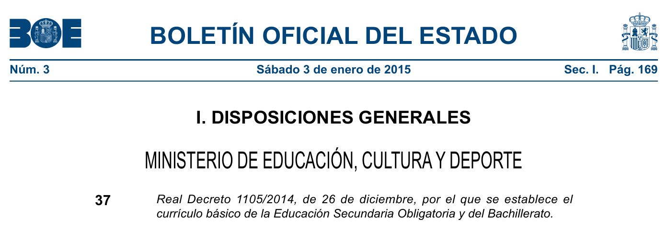
Introduction
Contents networks in highschool science education

Slide 3
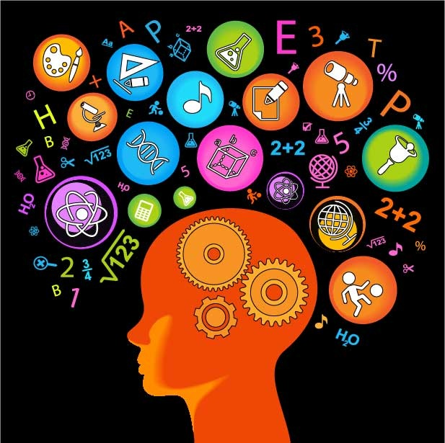
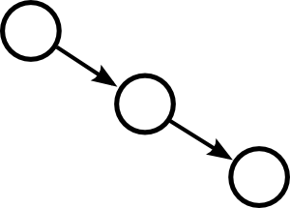
Introduction
Contents networks in highschool science education
Atomization into different subjects
(vs. integrated sciences)
Linear chain of contents not reflecting the complex structure of knowledge

Slide 4

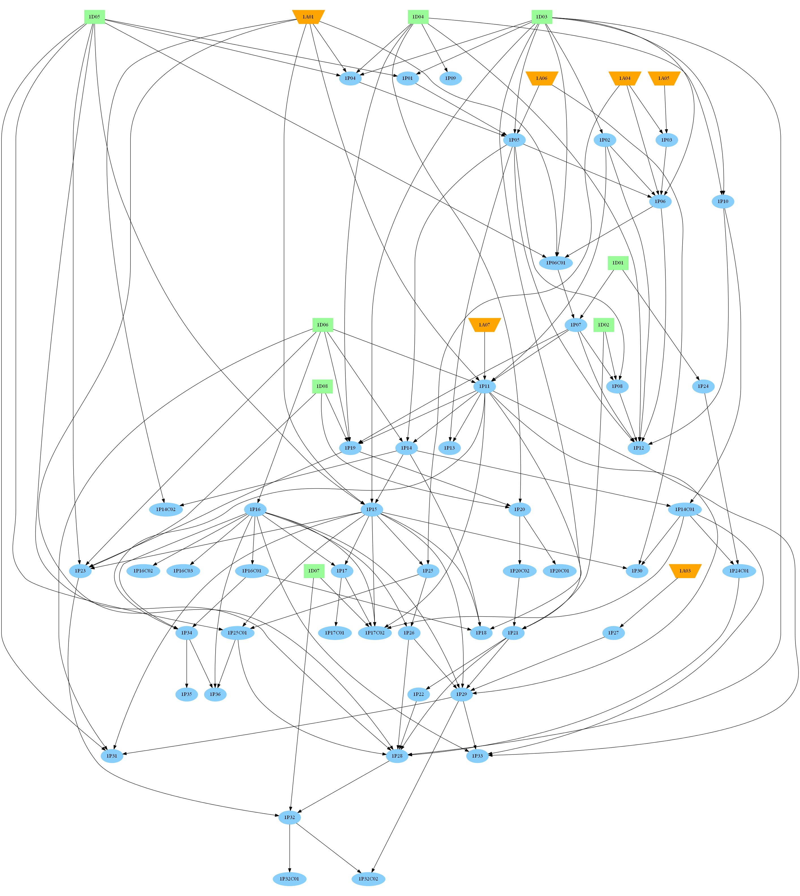
Introduction
Contents networks in highschool science education
Atomization into different subjects
(vs. integrated sciences)
Linear chain of contents not reflecting the complex structure of knowledge

Slide 5
Introduction
Contents networks in highschool science education
Atomization into different subjects
(vs. integrated sciences)
Linear chain of contents not reflecting the complex structure of knowledge
Can network theory help us find important contents, coherent groupings and ways of mixing subjects?

Slide 6
Outline
Contents networks in highschool science education
Generate the network of curricular contents (last year of highschool, only Physics and Mathematics).
Find most important contents (subjects in isolation and together).
Find coherent groupings of contents given the network structure (community structure).
Toward an integrated science teaching. Propose a grouping of Physics and Mathematics contents.
Conclusions.

Slide 7
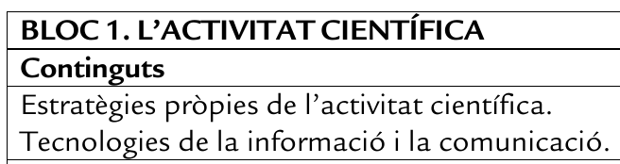
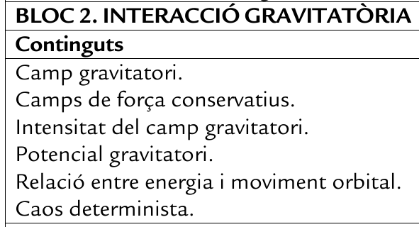
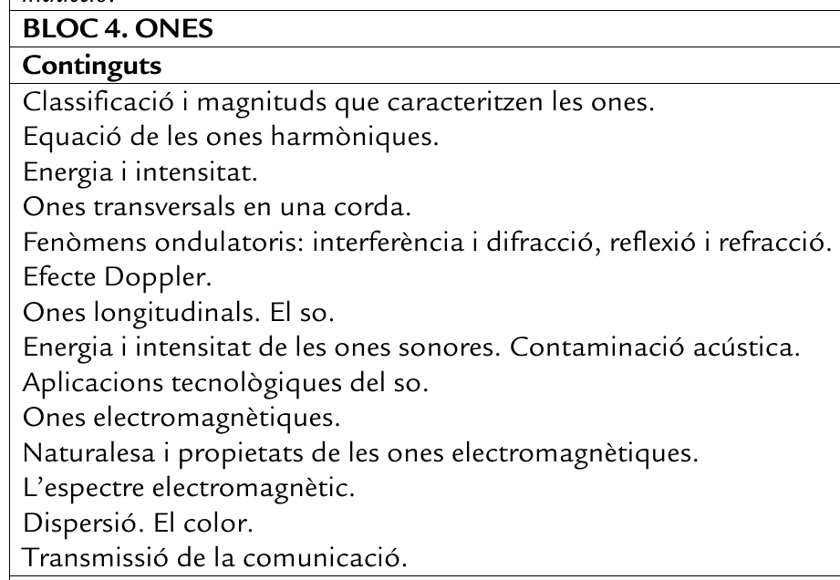
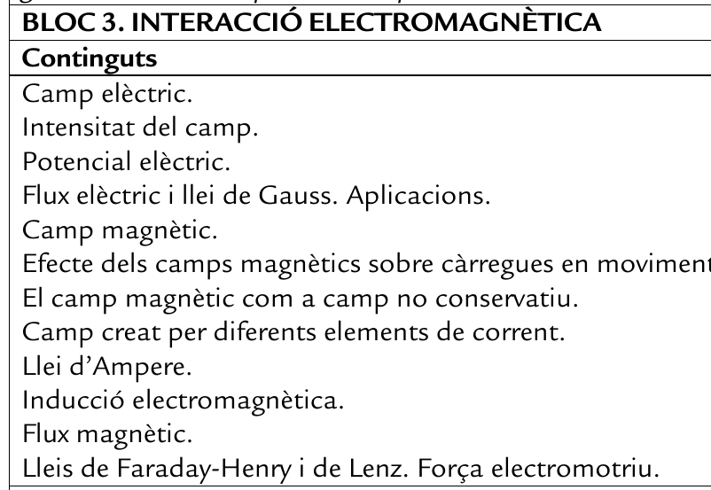
Contents networks in highschool science education
1) Generate the network of curricular contents
Physics: 54 contents in 6 blocs
Mathematics: 36 contents in 5 blocs
Total: 90 contents (4005 potential links)
Non-optimal solution: Check all relations one by one.
Two contents linked if they overlap in concepts or methods.
https://github.com/juanfernandezgracia/TFM_MFPR_Xarxes_continguts

Slide 8
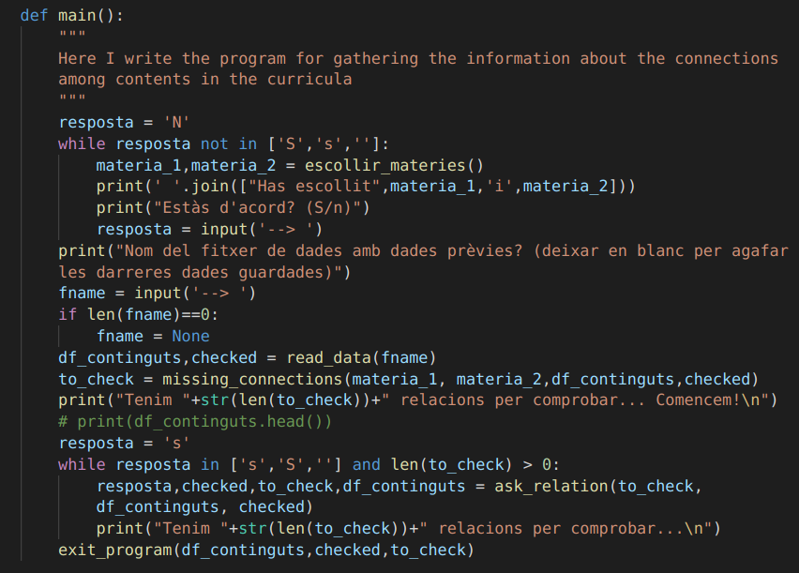
Contents networks in highschool science education
1) Generate the network of curricular contents
Physics: 54 contents in 6 blocs
Mathematics: 36 contents in 5 blocs
Total: 90 contents (4005 potential links)
Non-optimal solution: Check all relations one by one.
Two contents linked if they overlap in concepts or methods.
https://github.com/juanfernandezgracia/TFM_MFPR_Xarxes_continguts

Slide 9
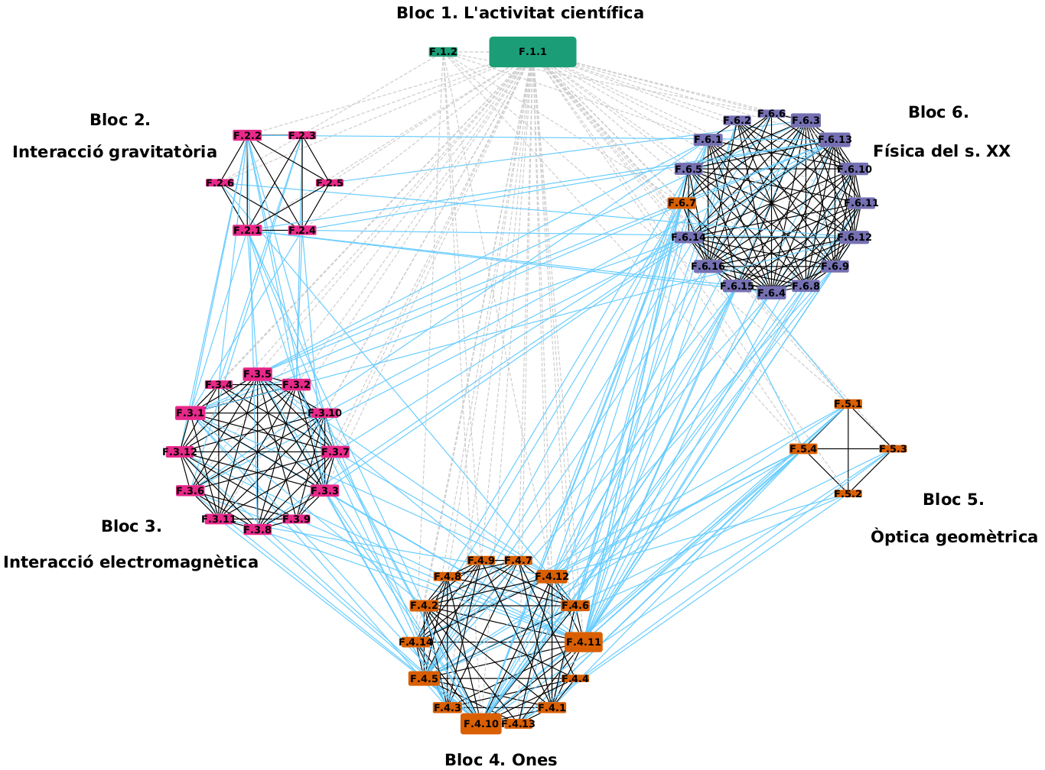
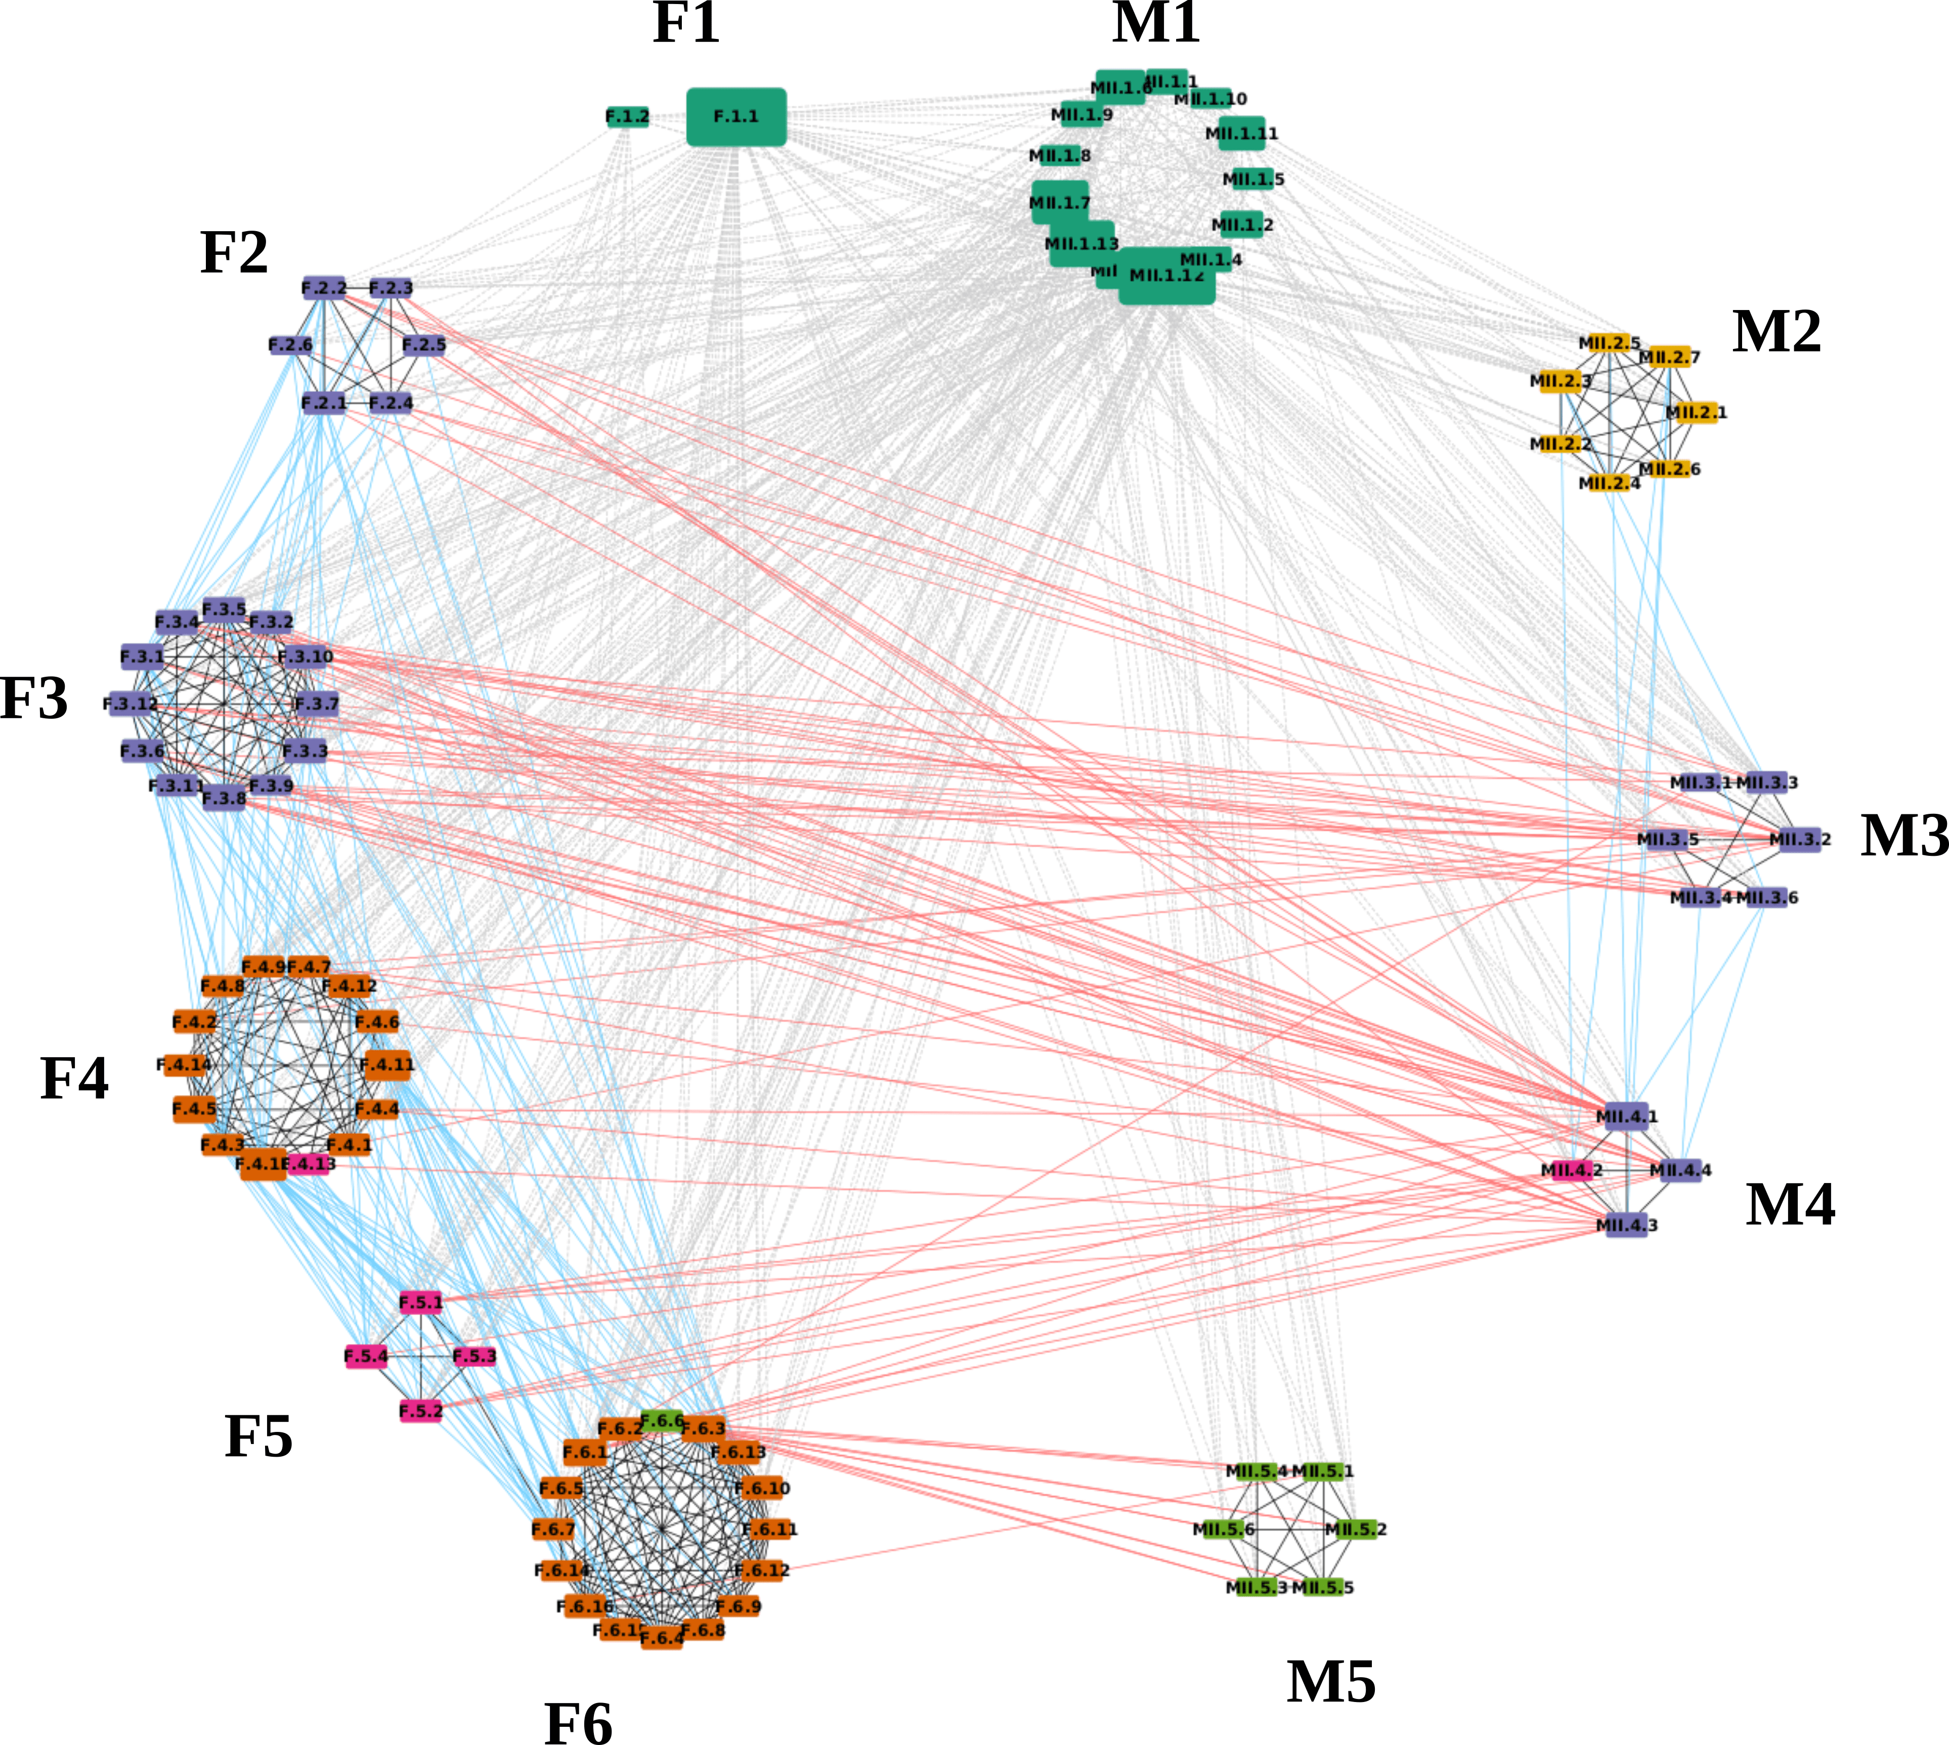
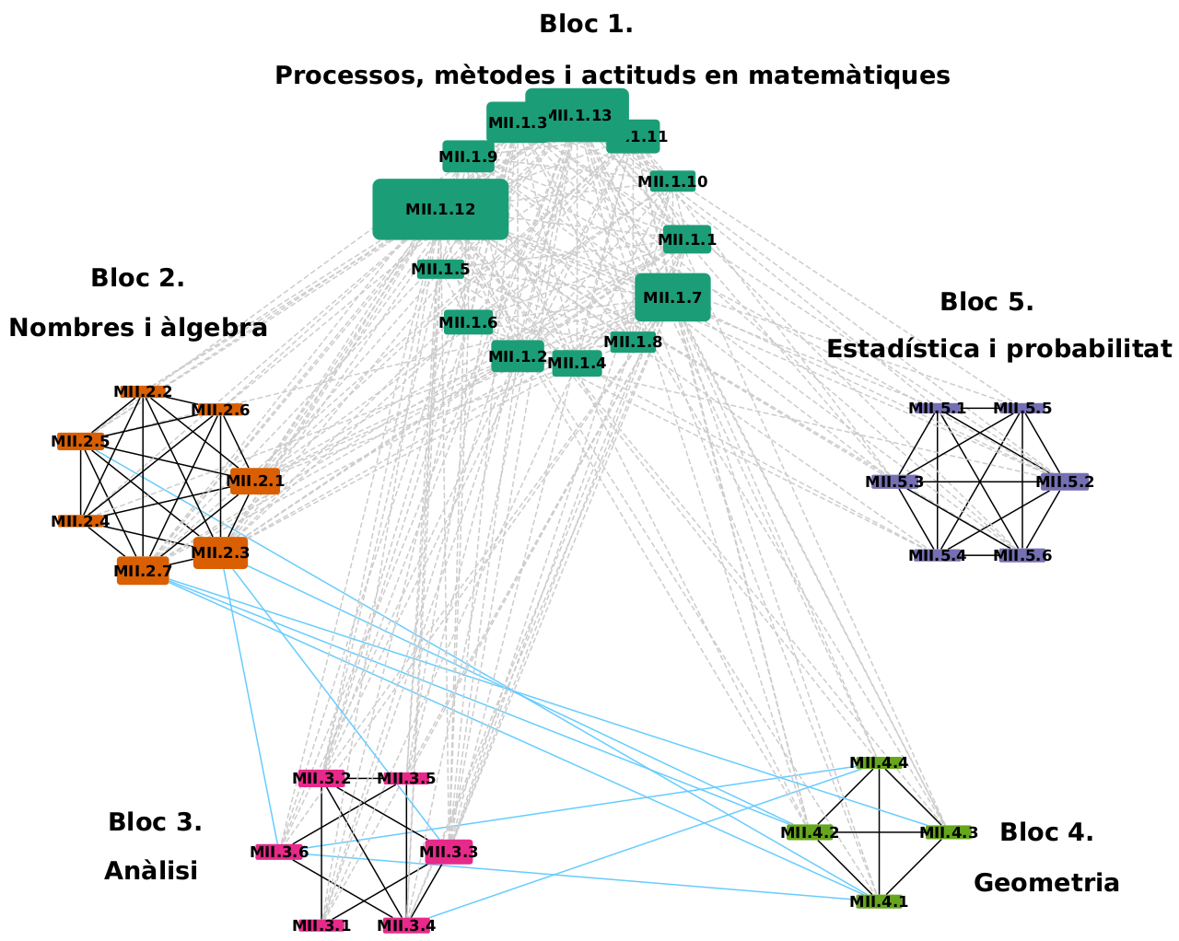

Contents networks in highschool science education
1) Generate the network of curricular contents
Physics
Mathematics

Slide 10
Contents networks in highschool science education
2) Find most central contents
Three different centrality measures that potentially can uncover different types of important contents:
Degree: Number of links attached to a content. Local and the most simple measure of centrality. A central content will be one that is directly connected to many other contents and thus will help understanding many others.
Closeness: Inverse of the average distance from one node to all other nodes taken through shortest paths. Global measure. A central content will be one that can be connected globally to the rest of contents in the network easily.
Betweenness: Proportion of shortest paths in the network that go through a node. A central content will be one that sits between different and topologically separated parts of the network in case there is some community structure and thus can serve as bridge between areas of contents.

Slide 11
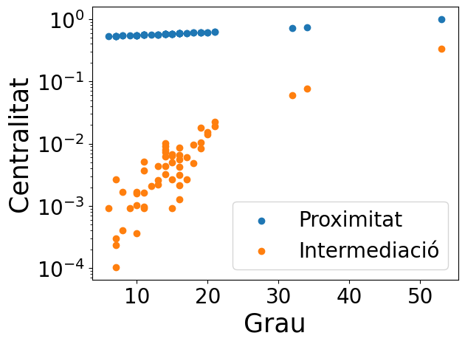
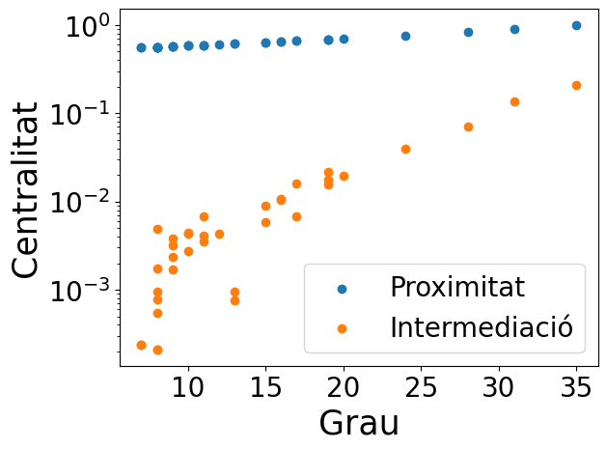
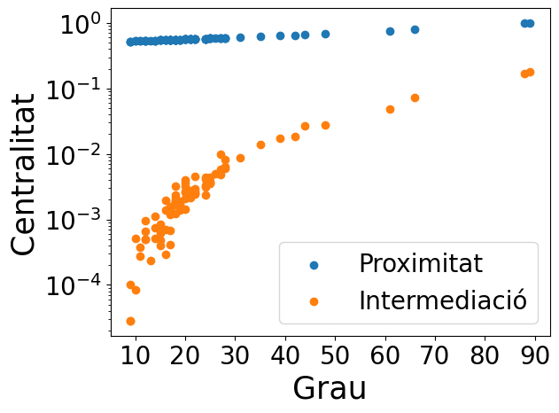
Contents networks in highschool science education
2) Find most central contents
Physics & Mathematics
Physics
Mathematics
The three measures are highly correlated (produce very similar top 10 central contents):
→ Not too complex structures to take into account.
→ We can use degree as centrality measure and forget about the others.

Slide 12
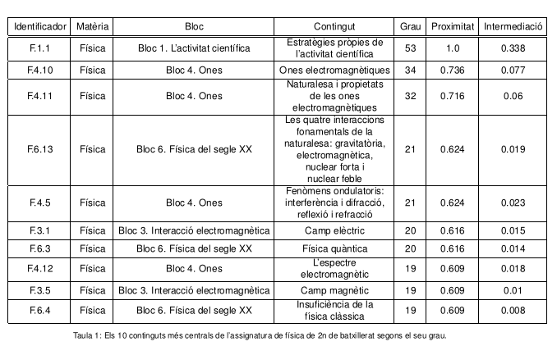
Contents networks in highschool science education
2) Find most central contents
Physics
Most central contents:
Block 1 (cross-disciplinary, cross-content?)
Block 4: electromagnetic waves contents (bridge many different blocks)
Block 6 : Physics of the XXth century (needs many previous contents)

Slide 13
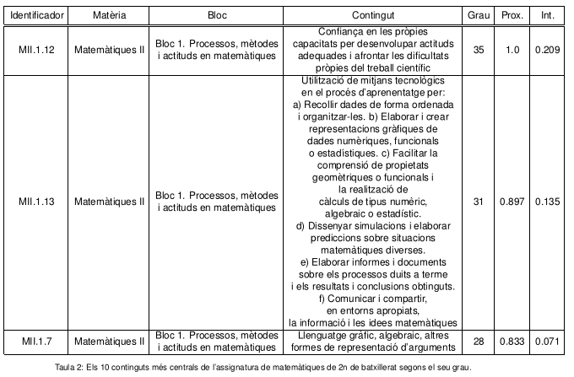
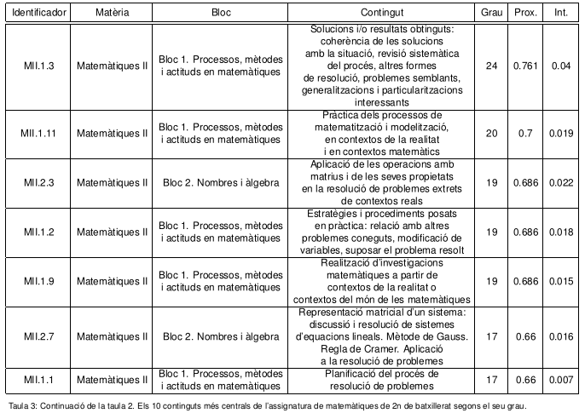
Contents networks in highschool science education
2) Find most central contents
Mathematics
Most central contents:
Block 1 (cross-disciplinary)
Block 2: contents related to matrices (connect different areas of mathematics)

Slide 14
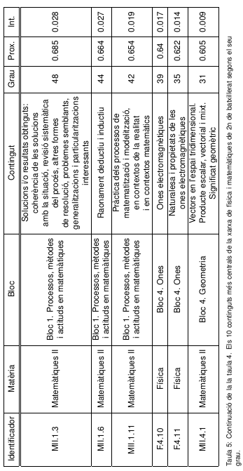
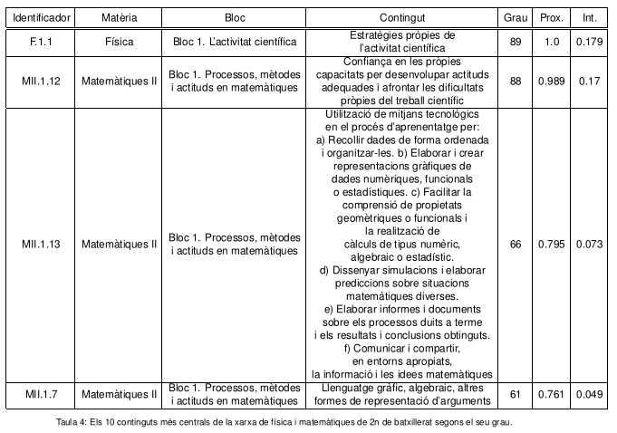
Contents networks in highschool science education
2) Find most central contents
Physics and Mathematics
Most central contents:
Block 1 from both subjects (cross-disciplinary)
Block 4 from physics (electromagnetic waves). Still link many different areas of the network.
Block 4 from mathematics (vectors). Very important for contents from physics. Reveal their true importance when the global network is taken into account!!

Slide 15
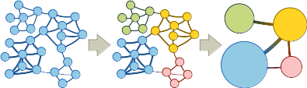
Contents networks in highschool science education
3) Find coherent groupings of contents
We will use the community structure of the network to propose groupings of contents that are coherent.
We will use Infomap to uncover the community structure, but other methods could be used.
We will exclude from the analysis the contents from the 1st block of each subject. We consider that these contents are cross-disciplinary and should be treated in class with any other content. Their high degree will obscure the community structure.

Slide 16
Contents networks in highschool science education
3) Find coherent groupings of contents
Physics
3 groups:
Blocks 2 & 3: gravitational and electromagnetic interactions.
Blocks 4 & 5 & a content from block 6 (application of quantum physics, the laser): Waves and geometric optics (+laser)
Rest of block 6: Physics of the XXth century.

Slide 17
Contents networks in highschool science education
3) Find coherent groupings of contents
Mathematics
4 grups that reflect the block structure of the curriculum.
If we ignore block 1, block 5 (statistics and probability) remains isolated from the network.

Slide 18
Contents networks in highschool science education
4) Toward an integrated science teaching.
5 grups (ignoring blocks 1 from each subject)
Blocks 2 & 3 from physics (gravitational and electromagnetic interactions) and blocks 3 & 4 from mathematics (analysis and geometry), except for the content “Equations for the line and plane in space” from the 4th block of mathematics.
Blocks 4 & 6 from physics (waves and physics of the XXth cent.), except for “Probabilistic interpretation of quantum physics” from block 6 and “Dispersion. Color” from block 4.
Block 5 from physics (geometrical optics) and “Equations for the line and plane in space” from block 4 from mathematics and “Dispersion. Color” from block 4 from physics.
Block 5 from mathematics (statistics and probability) and the content “Probabilistic interpretation of quantum physics” from block 6 from physics.
Block 2 from mathematics (numbers and algebra).

Slide 19
Conclusions
Contents networks in highschool science education
We have generated the network. →We have commited errors and tthere is a lot of personal bias. The process should be automated (NLP?). Nevertheless the results seem coherent. This method can serve as a tool to investigate mental maps of different groups of people (students, teachers, etc)
Most central contents can be categorized in 2 groups: 1) cross-disciplinary contents (blocks 1) & 2) contents linking different areas of knowledge (electromagnetic waves, matricess). When taking into account the joint network, vectors appear as a central content, which didn’t before. → Importance of the global picture.
Community structure in the isolated networks follows mostly the block structure of the curricula.
Community structure for the joint network serves as a guide to the integrated teaching of physics and mathematics. It is remarkable how the block “Statistics and probability” from mathematics, which was isolated from the rest of contents, now gains some context by teaching it together with the content “Probabilistic interpretation of quantum physics” from the 6th block of physics.
This proposal exemplifies the potential of network theory for curricular design.

Slide 20

Thanks page
THANK YOU
for your attention

